Slide 1
TUMORS OF THE SKIN OTHER THAN KAPOSI SARCOMA
PRESNTERS:
ALI SIMAI
HALIMA SULEIMAN
FACILITATOR: PROF. P . MUNSER

Slide 2
Objectives
Clear classification of the skin tumors
Describe their clinical presentations
How to identify lesions that need urgent biopsy
Discuss the epidemiology and risk factors of basal cell carcinoma, cutaneous squamous cell carcinoma and malignant melanoma
Outline the diagnostic work up and staging of malignant lesion
Evidence based management approach

Slide 3
Skin Tumor Classification
Skin tumors can be classified into;
  Benign tumors
  Pre-malignant tumors
  Malignant tumors

Slide 4
BENIGN TUMORS OF THE SKIN

Slide 5
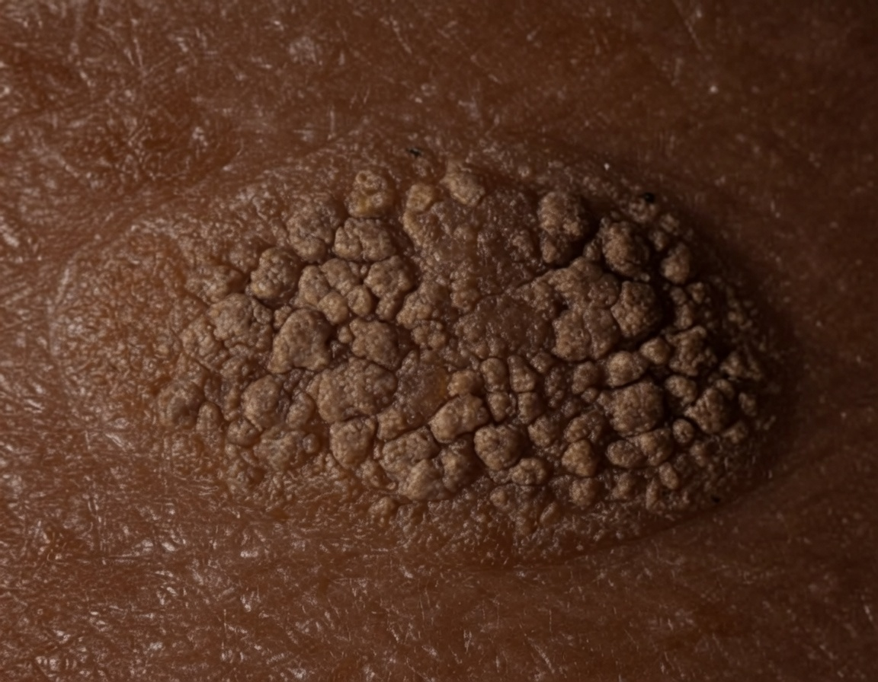
EPIDERMAL TUMORS
Seborrheic Keratosis
Common epidermal tumor
Consisting of benign proliferation of immature keratinocytes
It is commonly seen in middle aged individuals, but it can also develop in young adults
Presents as a well demarcated,round or oval lesion, light brown to dark brown and a typical stuck on appearance
It is generally asymptomatic,but chronic irritation due to friction trauma may occasionally cause pruritus,pain or bleeding.
Cluster on the trunk,inframammary folds,face/scalp

Slide 6
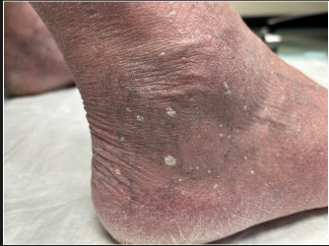
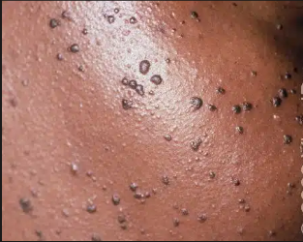
Suborrheic Keratosis Cont”
Clinical variants: include
Stucco Keratosis: White lessions with rough surface and stuck on apperence
Typically located on elderly ankles and dorsum of the feets
Dermatosis papulose nigra: Presents with brown to black papules
Predominatly located on the face and neck, that increase in number with age
Diagnosis: Clinical appearance
Treatment: Local destructive treatments
  Cryotherapy (liquid nitrogen}: first line treatment
  Electrodessication and Curettage: for large ad thick lesion
  Topical agents: 50% trichloroacetic acid(TCA) and tazarotene 0.1% ointment

Slide 7
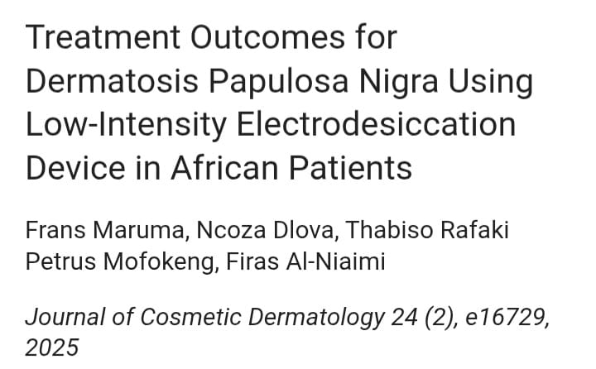

Slide 8
Article review
Study Objective: To evaluate the treatment outcomes of low-intensity electrodesiccation for Dermatosis Papulosa Nigra (DPN) in African patients.
Study Methods: Study design: Prospective interventional clinical study (single-arm)
Study Population: A total of 137 patients were included in the study, with the majority being female (n =129; 94.16%) compared with their male counterparts (n=8,5.84%). Most patients were under 40 years of age(n=74;54%),whereas the remaining were above 40 years of age(n =63,46%)

Slide 9
Cont……
Study Area: The study was conducted in South Africa.
Study period: January 2018-December 2021
Findings: The treatment resulted in the successful removal of most DPN lesions, high patient satisfaction, good cosmetic outcomes, and minimal complications. Most patients healed well without significant scarring or pigmentary changes.

Slide 10
Conclusion
Low-intensity electrodesiccation is a safe, effective, and inexpensive treatment for Dermatosis Papulosa Nigra in African patients, providing high lesion clearance, excellent cosmetic outcomes, high patient satisfaction, and minimal adverse effects. Further larger studies with longer follow-up are needed to confirm these findings.
Limitations: The study was conducted at a single centre, which limits the ability to generalise the results.

Slide 11
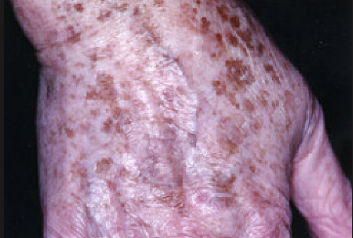
PIGMENTED LESIONS
Solar Lentigo
Is proliferation of normal melanocytes secondary to chronic solar damage
Synonyms: Senile lentigo and actinic lentigo.
These lessions occur most commonly in individuals with lightly pigmented skin with hx of chronic sun exposure, most found in adults and elderly
Occurs at the areas with chronic sun exposure with with predilection on the face, dorsum of the hands and fore arms
Presents as tan brown uniformly pigmented sharply demarcated (not always) macules, so called ink-spot lentigenes
DIAGNOSIS: Clinically; flat ,oval pigmented macules
TREATMENT:
  Cryotherapy and laser surgery can destroy them, but treatment may leave a temporary or permanent white or dark mark.
  Cysteamine cream hyperpigmentation treatment

Slide 12
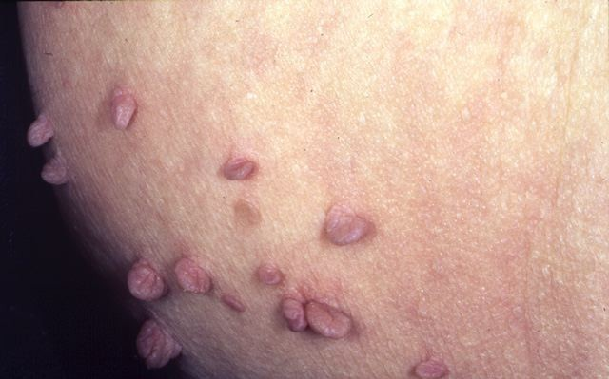
DERMAL TUMORS
Acrochordons(Skin tags)
Also known as fibroepithelial polyps
Benign outgrowths of normal skin
Commonly found in skin folds of the obese middle-aged women and in patients with diabetes mellitus
Skin colored, pedunculated or sessile, mostly in axillary, groin, neck, inframammary and eyelids
Asymptomatic, tenderness may be due to friction from ornaments or rubbed by clothing
DIAGNOSIS: Clinical appearance
TREATMENT: irritating and cosmetic desire
Excision with local anaesthesia with 1% lidocaine – epinephrine to lessen bleeding
Cryosurgery with liquid nitrogen

Slide 13
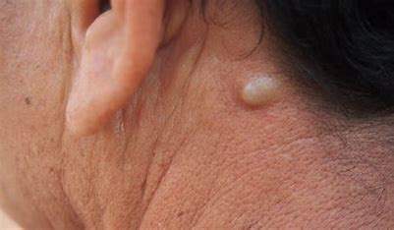
APPENDAGEAL(ADNEXAL) TUMORS
Sebacious cyst
Firm, subcutaneous, keratin filled cyst originating from hair follicle
Arises spontaneously after puberty
May be solitary on the trunk, neck, or post auricular area
Fixed to overlying skin by a punctum that represent a follicle
Can reoccur post drainage if cyst wall persists
DIAGNOSIS: Clinical appearance of discrete cyst or nodule with central punctum, that is freely movable on palpation.
Also can be confirmed by histologic examination(stratified squamous epithelium)
MANAGEMENT:
Surgical excision: best option when the lesion is not inflamed.

Slide 14
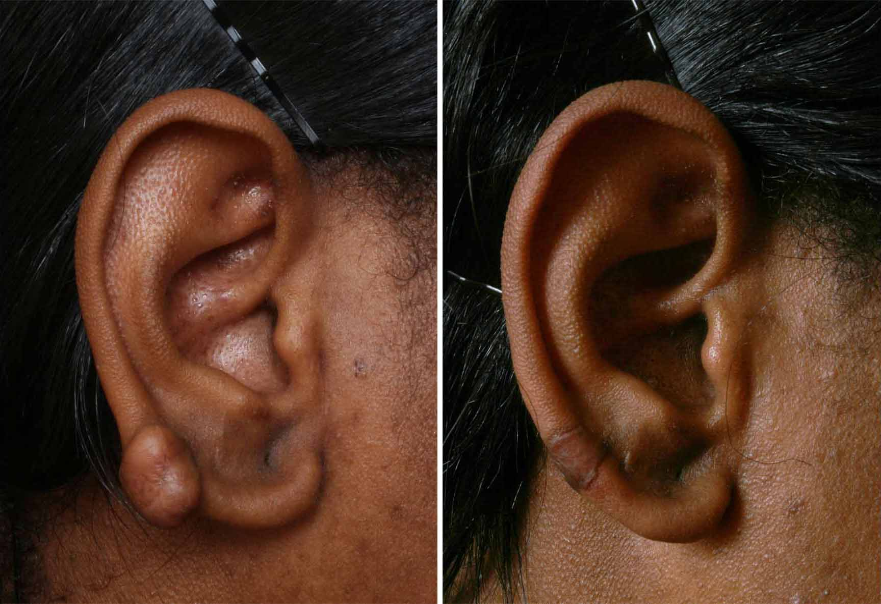
FIBROUS TUMOR
Keloids
Benign cutaneous lesion occurs due to overgrowth of fibrous tissue
Uncontrolled synthesis of dermal collagen
Extend to surround skin beyond the site of injury
May occur after injury, burns, surgery, lesser therapy or acne
Found on the upper back, chest, neck, sholders, jaw and ear lobes (Area with high tension on healing)
Hereditary predilition

Slide 15
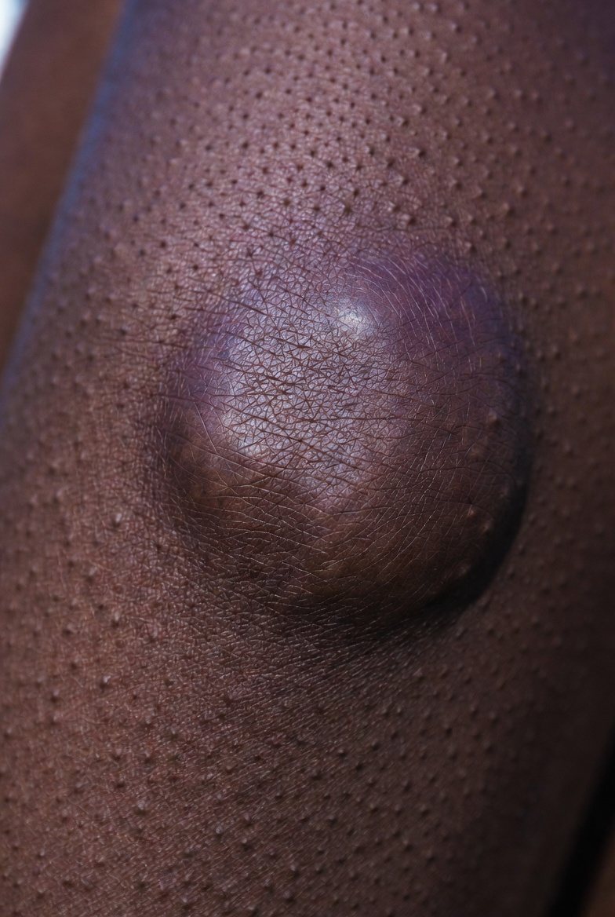
Clinical course
Early stage:
Soft and pink, resembles hypertrophic scar
Late stage
Firm and white, more protuberant than the original trauma, irregular borders, claw-like extension

Slide 16
Treatment of Keloids
Intra-lessional steroid injection
Triamcinoloneacetonide 10-4-mg/mil in varying dilution injected 3-6 wks till lesion flattens
Comibination of ILS+Hyaluronidase or 5FU for furster regression
Surgical excision followed by ILS
Cryotherapy with liquid hydrogen+ILS
Laser:CO2

Slide 17
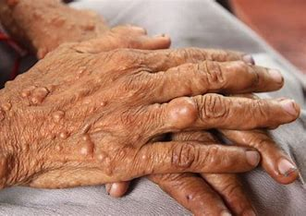
NERVE TUMOR
Neurofibromas
Seen as part of an autosomal dominant inherited condition-neurofibromatosis
These are pink coloured, soft, sessile or pedunculated papules or nodules <2 cm.
Applying direct pressure to some neurofibromas may make them seem to retract into the skin(buttonhole sign)
Plexiform neurofibromas occur along the course of peripheral nerves, creating irregular masses or tender nodules

Slide 18
Treatment
Excision is advised in case of
Cosmetics/painful lesions
Lesions on vital structures
Lesion suspected to undergo malignant changes(grow rapidly,persistent pain)

Slide 19
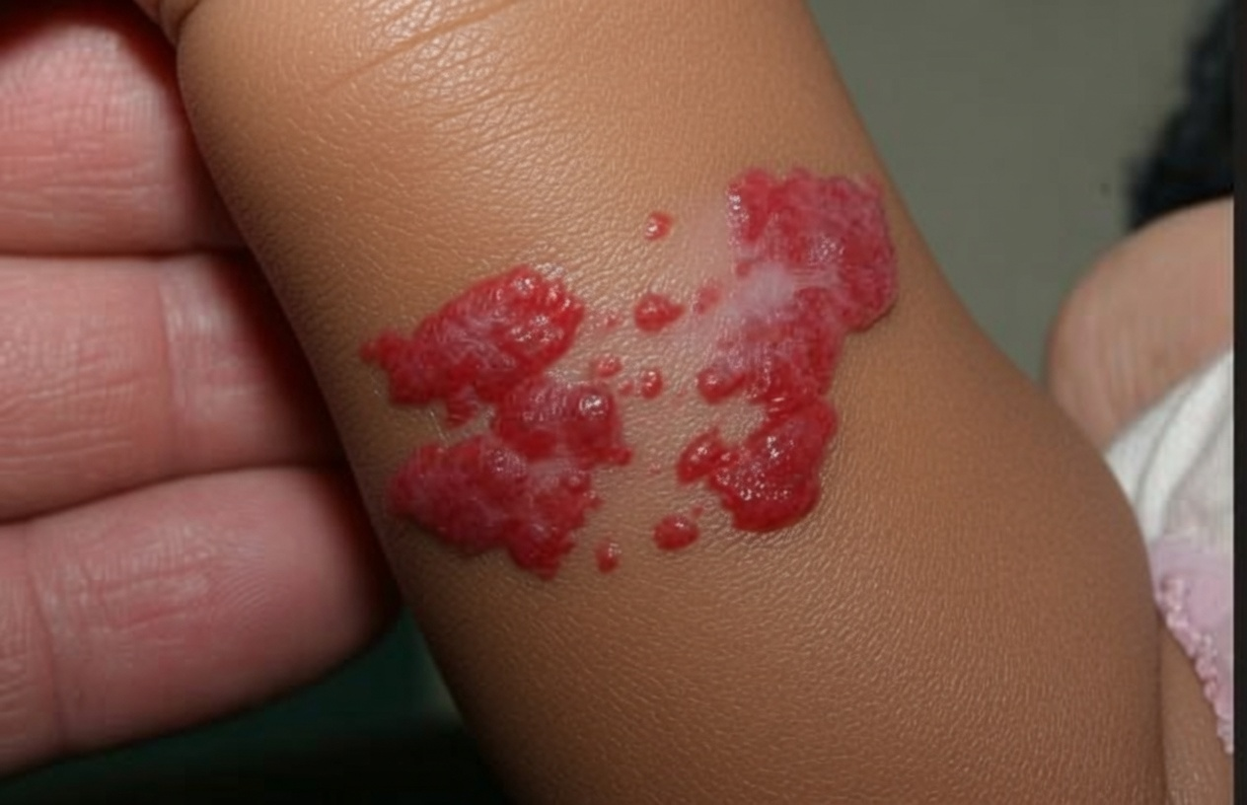
VASCULAR TUMORS
Infantile hemangioma:
Benign tumors of vascular endothelium
Also known as strawberry hemangioma.
Most common tumor of the childhood
Two to three times more common among females than males
The incidence increased in preterm infants
They are benign and self limiting though others can cause ulceration and life long disfigurement
Multiple hemangioma or segmental hemangioma can have the similar lesions on the liver, respiratory tract, auditory canal and GI tract.

Slide 20
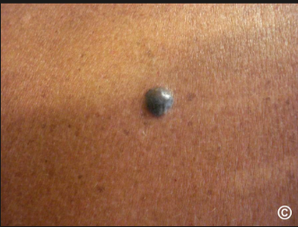
Cherry angiomas
Also known as Campbell de morgan spots
Mature capillary proliferation common in middle aged and older adult patient
Dome shaped, typically 0.1 to 0.4cm in diameter, do not blanch with pressure.
Occurs as multiple lessions on the trunk and may bleed profusely with any traumatic rupture
Pathogenesis is not yet unknown
DIAGNOSIS:
Based on the clinical appearance

Slide 21
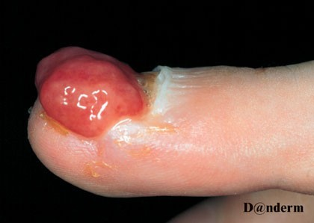
7.Pyogenic granuloma
Pygenic granulomas are benign overgrowth of blood vessels
They present as a rapidly growing pinkish red nodules which are friable and readily bleed
They may follow trauma and are often found on the fingers and lips
They are best excised to exclude an amelanotic malignant melanoma
Diagnosis
Based on clinical hx of an erythematous,dome shaped papule that bleeds easily and has developed over a few days to week
Histologic confirmation is always desirable because several benign and malignant lesions can mimic PG

Slide 22
Clinical course
Early may appear as flat and pale surface with few telangiectasia and dilated blood vessels
In growth phase, are bright red (Superficial) or purple(deep), firm and rubbery
Involuting hemangiomas are slate gray and soft

Slide 23
Treatment
Treament option may be:
  Steroid, sclerotherapy
  Embolization
  Compression
  lesser therapy

Slide 24
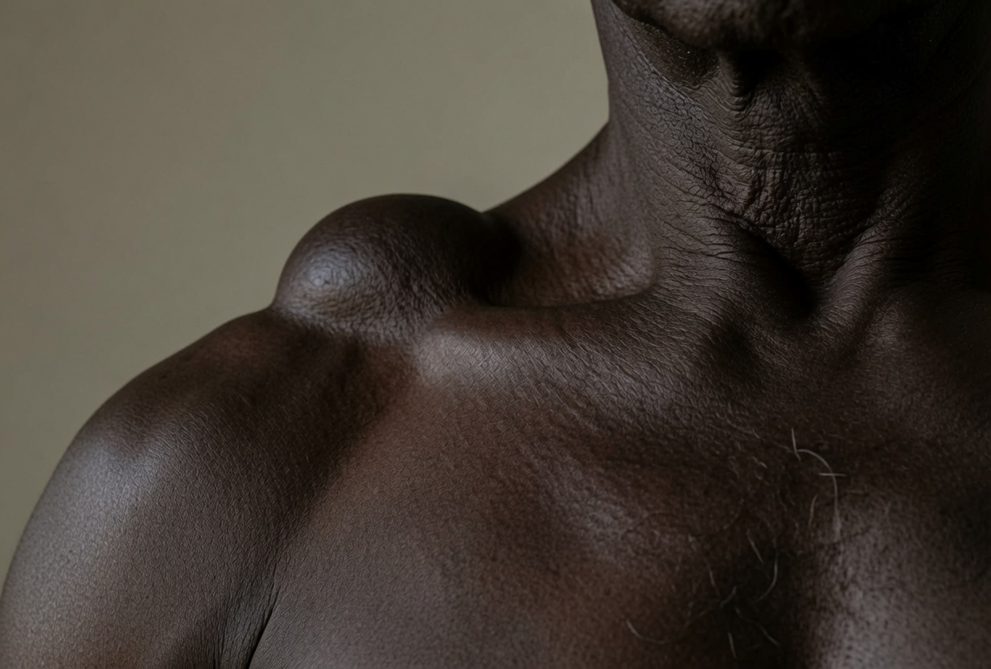
TUMORS OF SUBCUTANEOUS FAT
Lipoma:
Consist of mature fat cells enclosed by thin fibrous capsules.
Can occur on any part of the body and develop superficially in the subcutaneous tissue.
Present as soft , painless subcutaneous nodules ranging in size from 1to>10cm on trunk and upper extremities can be round , oval or multilobulated.
Malignant transformation of a lipoma into a liposarcoma is rare.
DIAGNOSIS
The diagnosis of lipoma is usually made clinically
Biopsy is indicated to confirm the diagnosis and exclude malignancy
MANAGEMENT: Surgical removal

Slide 25
PRE-MALIGNANT TUMORS OF THE SKIN

Slide 26
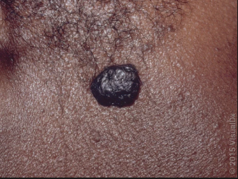
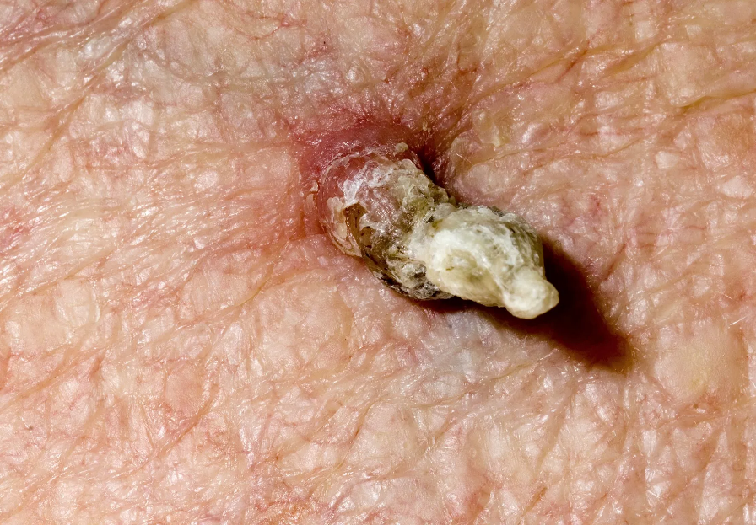
Actinic Keratosis
Common persistent keratotic lesions with malignancy potential
Synonymously termed as solar keratosis, keratinocytic intraepithelial neoplasia
UV radiation and is the major risk factor through the induction of mutations in epidermal keratocytes
Typically develop as solitary or multiple lesions on sun exposed areas such as balding scalp , neck ,dorsal hands and dorsal forearms
Asymptomatic scaly erthromatous patch or plaque about 2-10mm surrounded by rough adherent scales resemble sandpaper
Clinical variants: classic, hypertrophic, atrophic ,AK with cutaneous horn , pigmented ,actinic cheilitis
DIAGNOSIS: Clinical and biopsy may be warranted in malignancy suspect

Slide 27
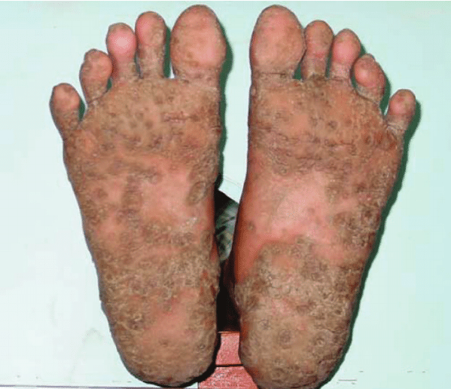
Arsenical Keratosis
ASK is the hyperkeratotic lesion occurs to patient previous exposed to arsenic
Lessions develop after latency period of 20-30 years
Water from wells and naturapathic medicine contain higher levels of arsenic
Presented as melanosis followed by yellowish pinpoint verrucious papules, 2-10mm in diameter.
Occurs at the thener area and lateral border of the palms, base and lateral surface of the fingers, soles, heels, and toes
DIAGNOSIS:
  Clinical diagnosis
  skin biopsy: Compact hyperkeratosis, acanthosis and papilomatosis

Slide 28
Treatment
Cryotherapy with liquid nitrogen or CO2
Electrodesication and curettage for larger lessions
5FU 5%cream and imuquimoid 5% cream for multiple lessios
Photodynamic therapy

Slide 29
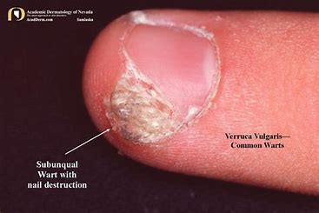
Verrucae Vulgaris
Also known as common wart
Also termed as viral wart, involving HPV1,HPV2, HPV4 to the lesser extent HPV7, HPV26-29,HPV77.
Occurs in 3.5% of adults,
Immunosuppression is a main risk factor, about 10% skin lesion occurs in renal transplant patient.
Common found on hands and fingers, less involves elbow, extensor areas and genitalia.
Presented as single or multiple veracious, keratotic papules or nodules,0.1-2cm in diameter.
Facial lesions appears as piliform.
DX: Clinical Dx and skin biopsy
Notes:
Occasionally presented as cutaneous horn

Slide 30
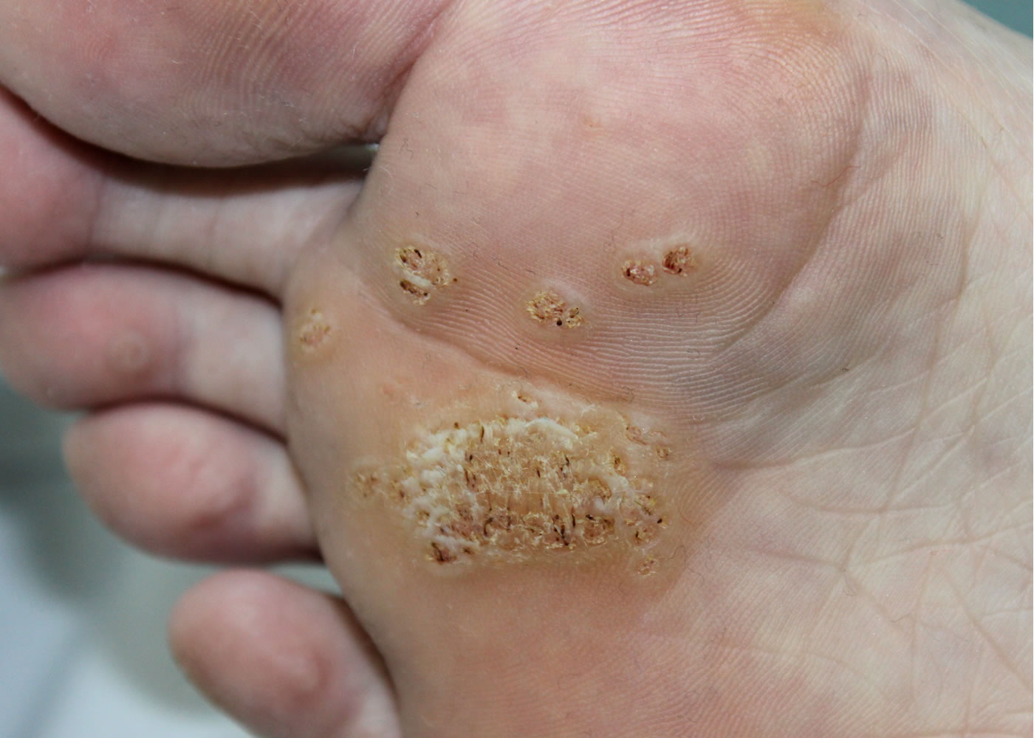
Verruca Plantaris
HPV induced benign epidermalproliferarive lesion affecting palm and soles
Synonyms:Plantar wart,planta verruca, palmoplantar wart.
Caused by infection with HPV1, HPV2, and HPV4 predominantly, HPV60 has been linked with verruca plantar is and epidermal cyst
Painful, hard, slightly elevated keratotic papule or nodule on plantar or palmar surface
More superficial form(HPV4 and HPV6) has fluent growth and resistant to treatment.
Black dots reflects vascular thrombosis
DIAGNOSIS;
  Clinical diagnosis
  Skin biopsy

Slide 31
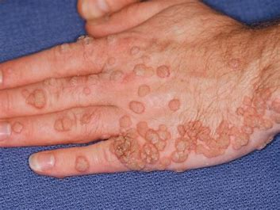
Verruca Planar
HPV induced characterized by flat topped cutaneous papules.
Synonyms : Plane wart, planter wart
Caused predominantly by HPV3 and HPV10.
Multiple plane wars occupying >5% of the BSA are potential harbinger of HIV infection
Founds in face, hands and shin
Smooth surfaced, skin coloured papules.
Redness or pigmentation indicates regression
DIAGNOSIS:
Clinically

Slide 32
Treatment
Topical tretinoin gel(0.025-0.1%)
Imiquimoid cream(3x to 6 wks)
Ablative lesser
Electrodessication

Slide 33
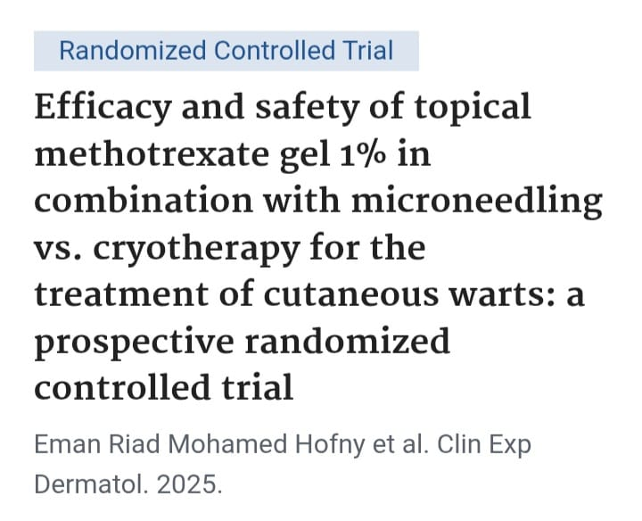

Slide 34
Article review
Study Objective: To investigate the efficacy and safety of topical methotrexate hydrogen 1% combined with microneedling in the treatment of cutaneous warts(common and plantar),compared with traditional cryotherapy
Study Methods: Study design: Prospective randomized controlled trial .
Group A:(34 patients): Topical MXT 1% with microneedling
Group B: (34 patients): Cryotherapy
Study Population: 68 patients with common or plantar cutaneous warts, randomized into two equal groups of 34 patients each

Slide 35
Cont……
Study Area: The study was conducted in a dermatology setting
Findings:
Efficacy : complete resolution cryotherapy group(65%,22/34),MXT +microneedling group(53%, 18/34)
Safety: No significant difference in pain or erythema btn 2 group. Blistering and hypopigmentation were significantly higher in the cryotherapy group
Recurrence: No recurrence in both groups during the 3-month follow-up

Slide 36
Cont..
Conclusion: Topical MXT hydrogen 1% + microneedling is an effective and safe therapeutic option in the treatment of common and plantar warts.
Limitations: small sample size, short follow-up period, no specific patient demographics or wart characteristics

Slide 37
SUMMARY FOR URGENT BIOPSY
Feature | Lesion Examples | Reason for Urgent Biopsy
Rapid growth | Pyogenic granuloma | Possible melanoma or vascular tumor
ABCDE changes | Pigmented lesion | Rule out melanoma
Non-healing ulcer | Actinic keratosis | Risk of squamous cell carcinoma
Bleeding/crusting | Cutaneous horn, seborrheic keratosis (atypical) | Malignant potential

Slide 38
Malignant Skin Tumors

Slide 39
Types of Skin Cancer
Malignant Skin Cancers
Nonmelanoma
Basal cell
Squamous Cell
Melanoma
Other
--Merkel cell
--Apocrine gland
--Cutaneous T-cell lymphoma
--Others

Slide 40
Basal cell carcinoma (BCC)
Basal cell carcinoma (BCC) is the most common cancer globally, comprising about 80% of all non-melanoma skin cancers
Arising from the basal layer of the epidermis and its appendages (pilosebaceous units). It is characterized by slow growth, local invasiveness, and extremely rare metastasis
Approximately 8 of every 10 cases of skin cancer are BCC
Basal cell carcinoma (BCC) and cutaneous squamous cell carcinomas (cSCC) are also collectively called “non-melanoma skin cancer” or “keratinocytic carcinomas”
Fania L, Didona D, Morese R, et al. Basal cell carcinoma: From pathophysiology to novel therapeutic approaches. Biomedicines. 2020;8(11):449. doi:10.3390/biomedicines8110449

Slide 41
Epidemiology
BCC is the most common human malignancy. It is particularly common in White populations but very uncommon in people with darky pigmented skin
However, estimates of incidence of BCC are imprecise since most countries do not have cancer registry that collects data on BCC.
American Cancer Society. Key Statistics for Basal and Squamous Cell Skin Cancers. https://www.cancer.org/cancer/basal-and-squamous-cell-skin-cancer/about/key-statistics.html (Accessed on December 16, 2024)

Slide 42
Global Incidence: Australia and New Zealand have the highest incidence rates of basal cell carcinoma (BCC) globally, exceeding 1,000 cases per 100,000 population annually, largely because of high ambient ultraviolet (UV) radiation exposure and predominantly fair-skinned populations. (Leiter et al., 2023; Fitzpatrick's Dermatology, 9th ed.)
Lower Rates: The incidence of BCC is substantially lower in regions with predominantly darker-skinned populations, such as much of Africa and Asia, because increased epidermal melanin provides protection against UV-induced DNA damage. (Leiter et al., 2023; Fitzpatrick's Dermatology, 9th ed.)
Leiter U, Keim U, Garbe C. Epidemiology of skin cancer: update 2023. Adv Exp Med Biol. 2023;1396:123–139.

Slide 43
Etiology and Risk Factors
Chronic ultraviolet (UV-B) exposure- (290–320 nm)
Fair skin (Fitzpatrick skin types I–II)
Increasing age
Male sex
Previous ionizing radiation exposure
Arsenic exposure
Immunosuppression
Genetic syndromes:
  Gorlin Syndrome
  Xeroderma pigmentosum
Previous history of BCC
Notes:
The Fitzpatrick skin type (phototype) classification is a system used by dermatologists to classify skin based on how it responds to ultraviolet (UV) exposure—specifically, how easily it burns and tans.

Slide 44
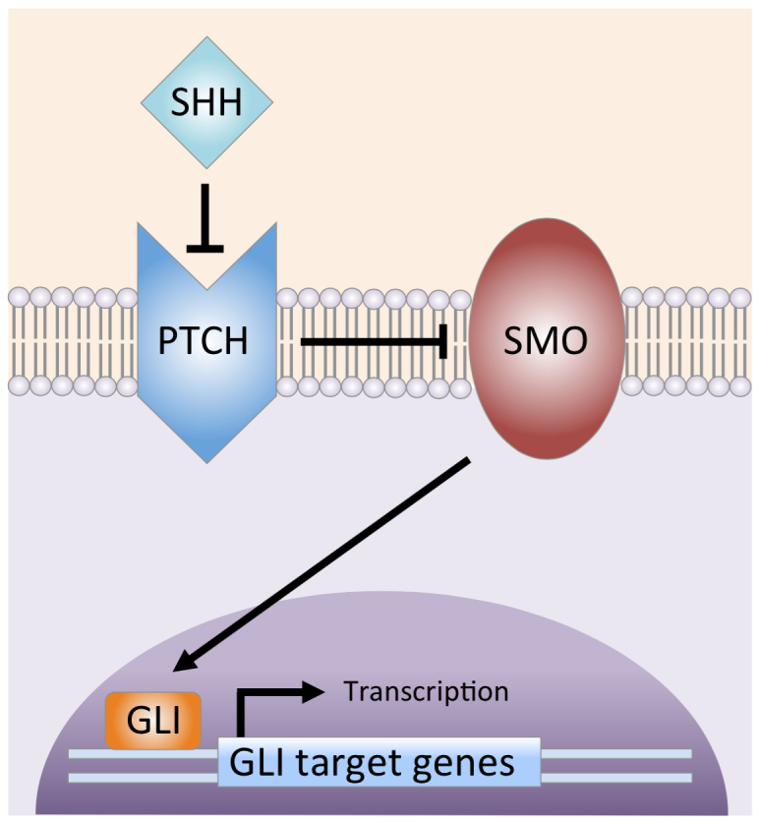
Hedgehog signaling pathway
The Hedgehog (HH) signaling pathway is a highly conserved molecular pathway that regulates embryonic development, cell proliferation, differentiation, and tissue repair.
In normal adult skin, the pathway is largely inactive except during wound healing and hair follicle maintenance. Constitutive activation of this pathway is the central molecular event in the pathogenesis of basal cell carcinoma (BCC), occurring in more than 90% of cases.
Notes:
Sonic hedgehog signaling pathway. SHH ligand binds to and inhibits the PTCH transmembrane protein. The inhibition of PTCH relieves suppression of SMO (Smoothened), which then activates the GLI transcription factors. The GLI proteins translocate from the cytoplasm to the nucleus, where they drive gene transcription.

Slide 45
UV-induced PTCH1 loss-of-function or SMO gain-of-function mutations cause constitutive Hedgehog pathway activation, leading to persistent GLI-mediated transcription and uncontrolled basal keratinocyte proliferation, the hallmark of basal cell carcinoma
Uncontrolled proliferation of basal keratinocytes results in tumor formation
In BCC, the Hedgehog pathway is constitutively activated, even in the absence of SHH ligand.
Common genetic alterations include:
PTCH1 loss-of-function mutation (≈70–90%)
  PTCH1 can no longer inhibit SMO.
  SMO remains continuously active.
  Persistent GLI activation results in uncontrolled keratinocyte proliferation.
SMO gain-of-function mutation (≈10–20%)
  SMO becomes constitutively active despite normal PTCH1.
  Continuous activation of GLI drives tumor formation.

Slide 46
Clinical presentations
Approximately 70 percent of BCC occur on the face, consistent with the etiologic role of solar radiation, and 15 percent present on the limbs and trunk
Only rarely of BCC diagnosed on areas like the penis, vulva, or perianal skin
Variety of clinical presentations due to various histopathological variants. Classical features are a pearly, telangiectatic papule, which may be eroded or ulcerated
Notes:
Shiny, skin-coloured bump that’s translucent

Slide 47
Clinical variant of BCC
Nodular BCC
The most common clinical subtype (account 80% of cases)
Occurs most often on the sun exposed areas of the head & neck
Appears as a translucent papule or nodule
Usually with telangiectasia and often a rolled border
Larger lesions with central ulcerations - referred to by the historical term ‘rodent ulcer’

Slide 48
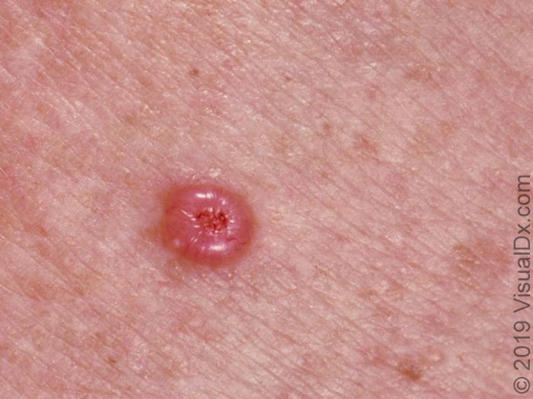
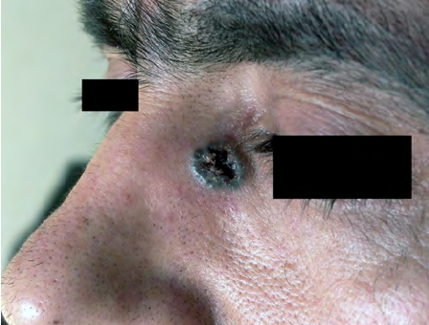
shiny, pink, telangiectatic nodule with a central erosion

Slide 49
Superficial BCC
Superficial BCC - most commonly on the trunk
Appears as - a well-demarcated erythematous macules, patches or thin plaques
The periphery may be rimmed with fine, translucent papules
Superficial BCC tend to grow slowly and can vary in size from macules measuring just a few millimeters in diameter to lesions several centimeters in diameter or more if left untreated. Superficial BCC are usually asymptomatic

Slide 50
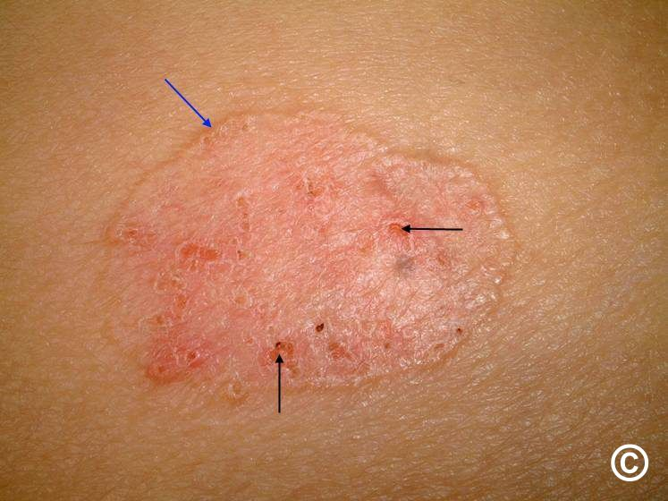
The DD nummular (discoid) dermatitis
An isolated patch of “eczema” that does not respond to treatment - raise suspicion for superficial BCC

Slide 51
Morpheaform bcc
Usually found in mid-facial sites
Waxy, scar-like plaque with indistinct borders
The appearance of scar tissue [in the absence of trauma/ previous surgical procedure or the appearance of atypical-appearing scar tissue at a previously treated lesion] - alert for possibility of morpheaform BCC
Wide and deep subclinical extension (The extent - often larger than the clinical appearance)
May infiltrate cutaneous nerves (perineural spread)

Slide 52
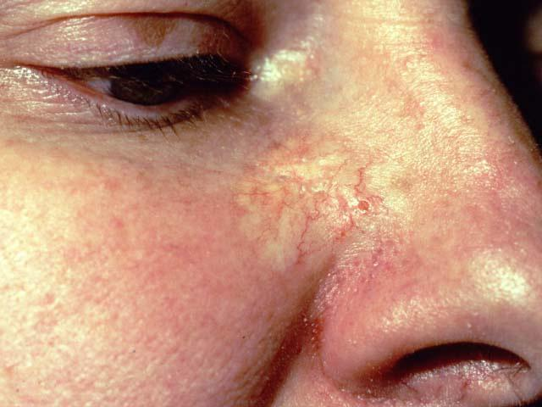
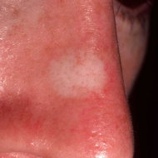

Slide 53
Basosquamous carcinoma
Mixed basal cell carcinoma (BCC) and squamous cell carcinoma (SCC)
Infiltrative growth pattern
Potentially more aggressive than other forms of BCC
Histologically - Shows both basal cell and SCC differentiation in a continuous fashion

Slide 54
Diagnosis
Based on
1. Clinical suspicion
Characteristic appearance of ulcerated nodule with a pearly, beaded margin, and telangiectasia.
Slow growth
Distinctive sites of occurrence
2. Confirmed by biopsy
Shave biopsy (most common)
Punch biopsy
Excisional biopsy

Slide 55
Risk stratification-NCCN
Risk stratification forms cornerstone of treatment of BCC
Low-Risk BCC
Well-defined borders
Primary lesion
Nodular or superficial subtype
No perineural invasion
Favourable location and size

Slide 56
High risk features
Tumor location
Tumor Location
Area | Sites
H-Area | Central face, eyelids, eyebrows, nose, lips, chin, ears, temple, genitalia, hands, feet
M-Area | Cheeks, forehead, scalp, neck, pre-tibia
L-Area | Trunk and extremities

Slide 57
Size criteria
Location | High risk size
H-Area | Any size
M-Area | ≥10 mm
L-Area | ≥20 mm
Additional High-Risk Features
Poorly defined borders
Recurrent tumor
Immunosuppression
Prior radiation therapy
Rapid growth
Perineural invasion
Aggressive histology

Slide 58
Treatment of low risk-BCC
1. Surgical Excision
The preferred treatment for most low-risk BCCs.
Recommended Margin
4 mm clinical margin
Outcomes
Cure rates exceed 95%
2. Curettage and Electrodesiccation (C&E)
Appropriate for:
Small primary lesions
Non-hair-bearing sites
Advantages:
Simple and inexpensive
Limitations:
No complete margin assessment
Not suitable for high-risk sites
Zitelli et al. Surgical margins for basal cell carcinoma
Notes:
Their analysis indicated that for well-circumscribed BCC lesions smaller than 2 cm in diameter, excision with 4-mm clinical margins should result in complete removal in more than 95% of cases

Slide 59
3. Topical Therapies
Imiquimod 5% Cream
Indications:
Superficial BCC
Mechanism:
Activates innate and adaptive immune responses
5-Fluorouracil (5-FU)
Indications:
Selected superficial lesions
Both agents demonstrate lower cure rates than surgery

Slide 60
4. Photodynamic Therapy (PDT)
Uses:
Superficial BCC
Thin nodular BCC
Advantages:
Excellent cosmetic results
Limitations:
Higher recurrence compared with surgery

Slide 61
Management of High-Risk BCC
1. Mohs Micrographic Surgery (MMS)
Preferred treatment for:
H-zone facial tumors
Recurrent lesions
Aggressive histologic subtypes
Tumors with poorly defined margins
Tissue-conserving situations
Mohs surgery is considered the gold standard for high-risk BCC.

Slide 62
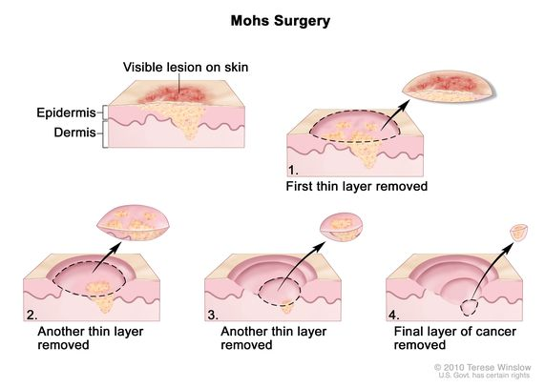
Technique: Involves microscopically controlled surgical removal of tumors, ensuring careful histological excision of malignant cells in all planes during surgery itself
Advantages
Complete margin assessment
Maximal tissue preservation
Lowest recurrence rates

Slide 63
2. Radiation Therapy
Indications
Poor surgical candidates
Elderly patients
Difficult anatomical sites
Adjuvant treatment after incomplete excision
Perineural invasion
Advantages
Effective local control
Disadvantages
No histologic margin control
Late skin changes and fibrosis

Slide 64
Local advanced and metastatic BCC
Locally Advanced BCC
Defined as tumors that:
Cannot be completely excised
Are not suitable for radiotherapy
Invade critical structures
Examples:
Orbital invasion
Extensive facial destruction
Skull base involvement
Metastatic BCC
Rare (<1% of all BCCs).
Common metastatic sites include:
Regional lymph nodes
Lungs
Bones

Slide 65
Systemic therapy
1. Hedgehog Pathway Inhibitors
Examples; Vismodegib and Sonidegib
Indications:
Locally advanced BCC
Metastatic BCC
Clinical Benefits
Tumor shrinkage
Improved local disease control
Common adverse effects
Muscle cramps
Alopecia
Weight loss
Fatigue

Slide 66
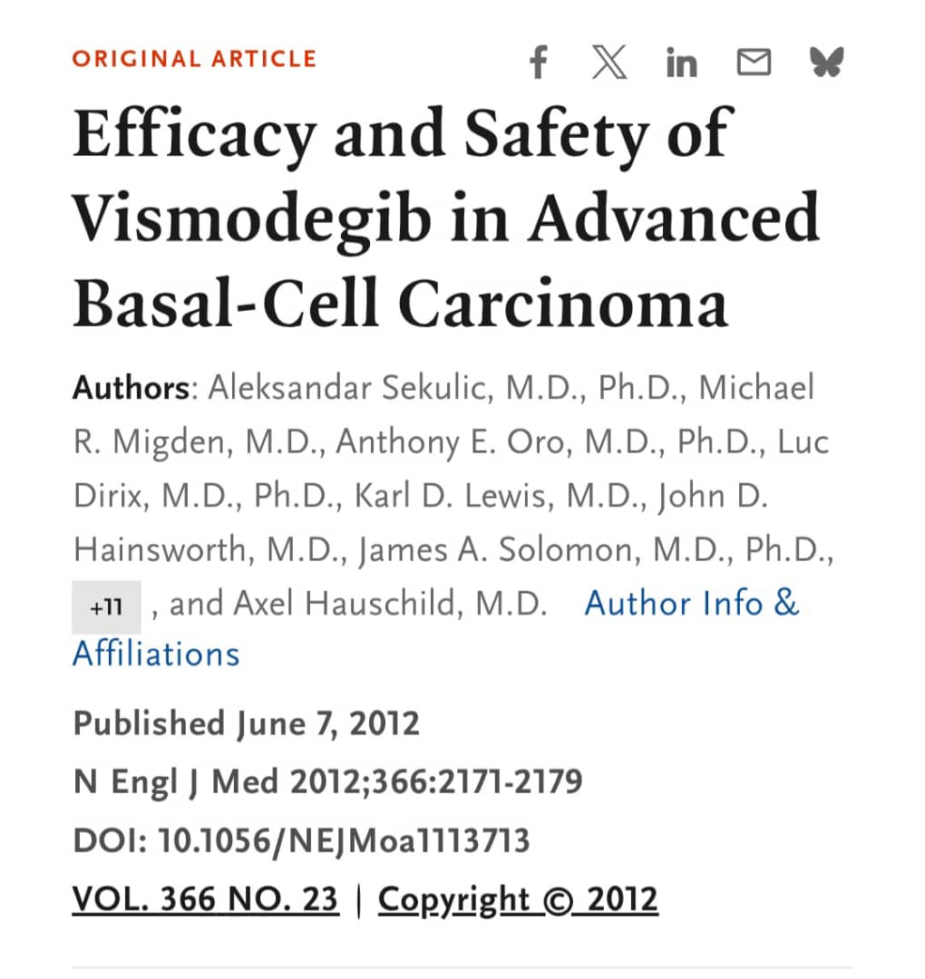
ERIVANCE BCC Trial (Vismodegib)

Slide 67
Article review
Objective
To evaluate the efficacy and safety of vismodegib in patients with locally advanced basal cell carcinoma (laBCC) or metastatic basal cell carcinoma (mBCC)
Study design
Phase II International Multicenter Open-label Single-arm trial
Study population
104 patients
  71 with locally advanced BCC
  33 with metastatic BCC
Patients were not candidates for surgery or radiotherapy.

Slide 68
Intervention
Vismodegib 150 mg orally once daily
Primary Endpoint
Objective Response Rate (ORR)
Complete response (CR)
Partial response (PR)
Measured according to RECIST criteria (for mBCC) and a composite assessment (for laBCC).

Slide 69
Key results
Conclusion
Vismodegib produced meaningful and durable responses in patients with advanced BCC and became the first FDA-approved Hedgehog pathway inhibitor.
Limitations
No control group
Small sample size
Open-label design
Short follow up
Outcome | Metastatic BCC | Locally Advanced BCC
Objective response | 30% | 43%
Complete response | Rare | 21%
Median duration of response | 7.6 months | 7.6 months

Slide 70
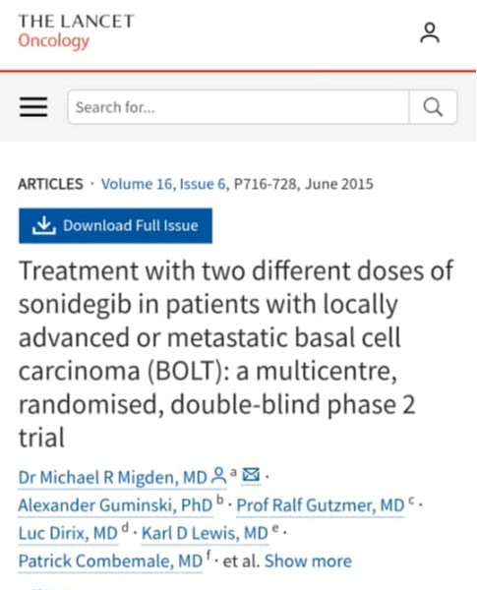
BOLT Trial (Sonidegib)

Slide 71
Article review
Objective
To assess the efficacy and safety of sonidegib in advanced BCC
Study design
Phase II Randomized Double-blind Multicenter
Study population
230 patients
Locally advanced BCC
Metastatic BCC

Slide 72
Treatment Arms
Sonidegib 200 mg daily
Sonidegib 800 mg daily
Primary Endpoint
Objective Response Rate (ORR)
Key results
200 mg group
Safety
The 200mg dose had
Similar efficacy
Significantly fewer adverse events
Therefore it became the approved dose.
Disease | ORR
Locally advanced BCC | 56%
Metastatic BCC | 8–17%

Slide 73
Conclusion
Sonidegib demonstrated durable responses in advanced BCC with a more favorable benefit–risk profile at 200 mg once daily
Limitations
Few metastatic BCC patients
No placebo or active comparator
Long-term resistance not fully evaluated

Slide 74
2. Immunotherapy
Cemiplimab
A PD-1 immune checkpoint inhibitor
Indications
Patients with:
Progression on Hedgehog inhibitors
Intolerance to Hedgehog inhibitors
Benefits
Durable responses
Improved disease control in advanced BCC

Slide 75
Follow-Up and Surveillance
Low-Risk BCC
Clinical examination every 6–12 months
High-Risk BCC
Every 6–12 months for the first 5 years
Annually thereafter
Patients should be educated regarding:
Monthly self-skin examination
Sun protection measures
Early recognition of recurrence

Slide 76
Prognosis
Overall, the prognosis for BCC is excellent. Most cases can be treated and cured with surgical resection of the lesion. The risk of death from BCC is highest in patients who are immunocompromised and in older adults.
Basal cell carcinoma has low potential to metastasize; however, when it does spread, it is associated with poor outcomes. The estimated median overall survival of a patient with BCC ranges from 8 months to 7.3 years
Key statistics for basal and squamous cell skin cancers. American Cancer Society. Updated October 31, 2023. Accessed May 8, 2024. https://www.cancer.org/cancer/types/basal-and-squamous-cell-skin-cancer/about/key-statistics.html

Slide 77
Squamous cell carcinoma (SCC)
SCC - second most common skin cancer, in immunocompetent after basal cell carcinoma
The most common skin cancer - in immunosuppressed organ transplantation recipients
Majority of SCC - present with early-stage disease
Prognosis - excellent in the majority of cases
Risk of developing metastasis from SCC is generally low

Slide 78
Etiology and risk factors
SCC usually develops in damaged skin, though it can also occur de novo. Several factors have been implicated in pathogenesis of SCC
Damaged skin
In Whites: Most frequent cause of skin damage is actinic damage due to prolonged, cumulative exposure to sunlight (manifesting as actinic keratoses).

Slide 79
In non-Whites: SCC occurs at sites of chronic inflammation and irritation due to:
Scars: burns
Dermatitis: radiodermatitis, erythema abigne, friction dermatitis.
Nonhealing ulcers: stasis ulcer.
Chronic granulomas: lupus vulgaris and granuloma inguinale
Leukoplakia: in oral mucosa
Erythroplasia of Queyrat: on genital mucosa

Slide 80
Carcinogens
Pitch tar, mineral oils, and inorganic arsenic are established carcinogens.
Genetic disorders
Certain rare genetic disorders, with defective DNA repair mechanisms, such as xeroderma pigmentosum
Infections
Human papilloma virus (HPV)
Infectious granulomas: Like lupus vulgaris and granuloma inguinale

Slide 81
Clinical presentations
Cutaneous squamous cell carcinoma (cSCC) can develop on any surface of the skin, but sun-exposed sites are the most common locations in individuals with lightly pigmented skin.
Involvement of other areas, in particular the lower legs and anogenital region, is more in people with darky pigmented skin
Cutaneous squamous cell carcinoma is typically characterized by a scaly, erythematous, or hyperpigmented papule or plaque.
Some cases may exhibit ulceration, fungating features, or pain

Slide 82
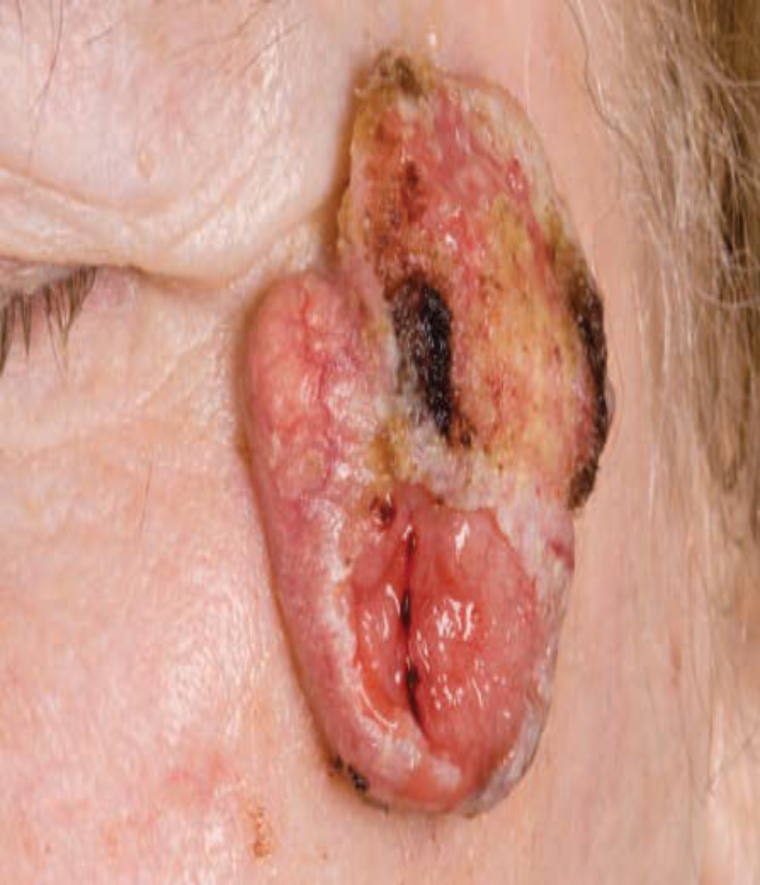
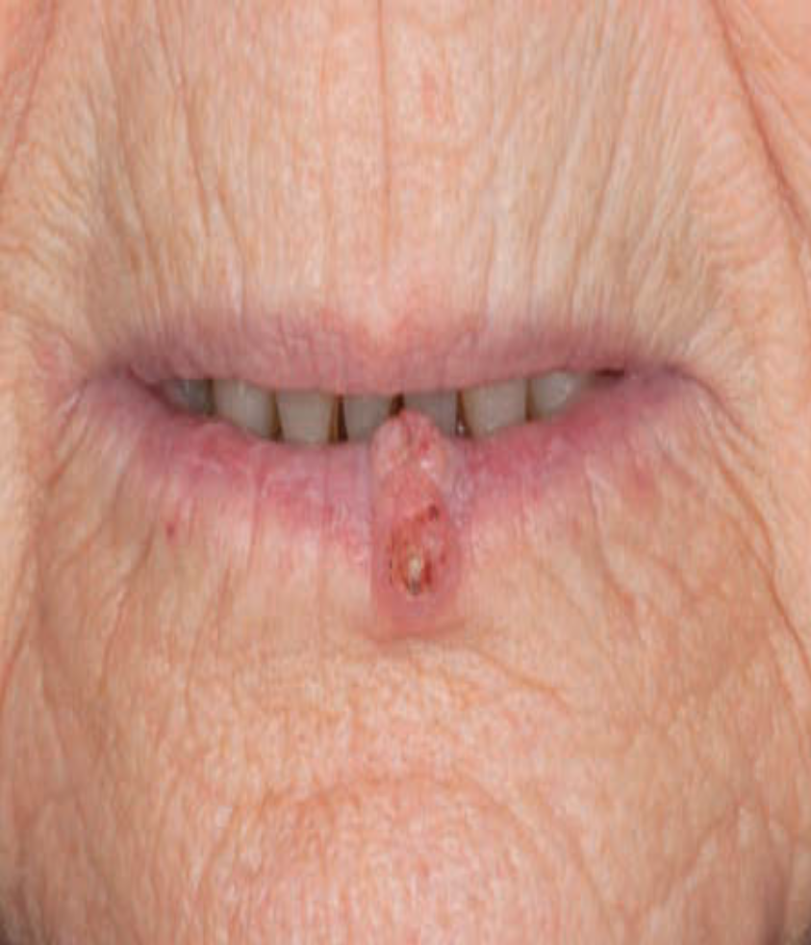

Slide 83
Metastases
Lymphadenopathy: Regional lymphadenopathy. Nodes hard and sometimes fixed to underlying structures and tethered to skin
Visceral metastases: Infrequent
Course
SCC arising in actinic keratoses seldom metastasizes.
SCC arising in scars, radiation dermatitis, and mucosae often metastasizes to regional lymph nodes

Slide 84
Diagnosis
A skin biopsy is necessary to confirm the diagnosis of cutaneous squamous cell carcinoma
Methods
Punch biopsy
Incisional biopsy
Excisional biopsy
Shave biopsy

Slide 85
TREATMENT
Aim of treatment is to ensure complete removal/destruction of the primary tumor and to prevent
metastases.
Surgery
Indications: Surgical excision of tumor is the treatment of choice.
Margin of excision: Lesion <2 cm diameter: 0.5 cm margin of normal skin all around.
Larger lesions: larger margin.
Radiotherapy
Though radiotherapy is effective, it is generally reserved for frail elderly patients.

Slide 86
OTHER THERAPIES
Topical therapeutic treatments- e.g. imiquimod, topical or intralesional 5-fluoruracil, cryotherapy & PDT – Lack of evidence for the efficacy
Radiation therapy - patient preference and other factors, e.g. problematic locations for surgery
Limited data on the efficacy of chemotherapy for metastatic SCC
Standard options in metastatic or unresectable disease – systemic platinum-based chemotherapeutic regimens, 5- fluorouracil/capecitabine, or monotherapy/chemotherapy with methotrexate

Slide 87
PROGNOSIS
Majority of SCCs- low risk
If early stage- result in a high cure rate with excellent prognosis
Prognosis for locally advanced SCC at the time of diagnosis & patients with progressive disease after first-line surgical therapy - usually poor
A poorer outcome of immunosuppressed patients with advanced disease

Slide 88
MALIGNANT MELANOMA (MM)
Definition
Malignant melanoma is a malignant neoplasm of melanocytes, most commonly cutaneous but also arising in uveal, mucosal, and other sites
Although it accounts for a minority of skin cancers, it causes the majority of skin cancer-related deaths because of its high metastatic potential.

Slide 89
Epidermiology
Global Burden
According to the latest Global Cancer Observatory (GLOBOCAN 2022) estimates:
Approximately 331,722 new melanoma cases were diagnosed globally in 2022.
Approximately 58,667 deaths occurred worldwide.
Melanoma ranks as the 17th most common cancer globally.
The age-standardized incidence rate (ASIR) is approximately 3.2 per 100,000 population.
International Agency for Research on Cancer. Global Cancer Observatory (GLOBOCAN 2022).

Slide 90
Cont…
Africa
Africa has among the lowest melanoma incidence rates worldwide.
Reasons include:
Higher skin phototypes (Fitzpatrick V–VI)
Increased epidermal melanin protection against UV-induced DNA damage
Lower prevalence of intermittent intense UV exposure patterns associated with melanoma
Most African regions report:
Incidence rates below 1 per 100,000 population
Mortality rates below 0.5 per 100,000 population

Slide 91
Risk factors
UV radiation exposure
History of severe sunburns (particularly blistering sunburns)
Excessive recreational sun exposure
Use of tanning bed
Phenotypic (host) factors- light skin pigmentation, red or blond hair, blue or green eyes and freckling tendency which reflect skin sensitivity to sun light
Personal and family history of melanoma
Melanocytic Nevi (mole) >(50-100)
Immunosuppression-HIV, lymphoma and organ transplant recipients
Environmental and occupational factors
Chronic exposure to UV radiation
Living in areas with high sunlight intensity such as Australia and New Zealand
Genetic disorders such as Xeroderma pigmentosa
Notes:
Tanning bed use fluoresescent bulbs that mimic the sun’s UVA rays
10 minutes in tanning bed is equal to about 2 hours of laying out in the hot sun

Slide 92
Clinical features
A variety of clinical variants described:
Lentigo maligna melanoma
Superficial spreading melanoma(SSM)
Acral lentiginous melanoma
Nodular malignant melanoma (NMM)
SSM is the most frequent while NMM is the most aggressive

Slide 93
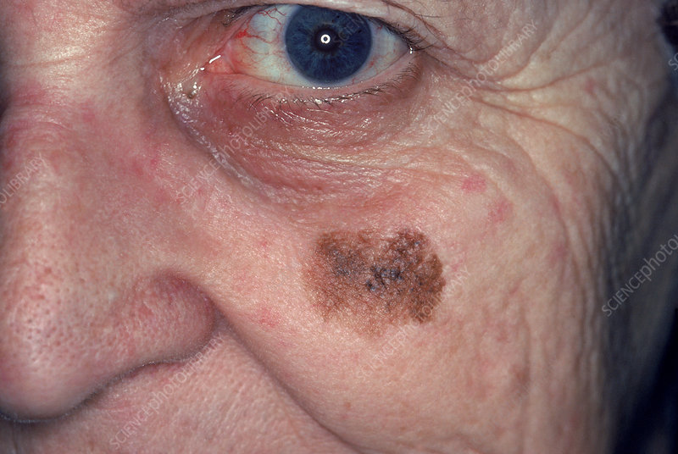
Lentigo maligna melanoma
Most frequently seen in elderly.
Infiltrated nodule develops in a pre-existing irregularly pigmented (brown to black) macule (lentigo maligna), which has been present for several years
Seen on photo-exposed parts (face and neck)

Slide 94
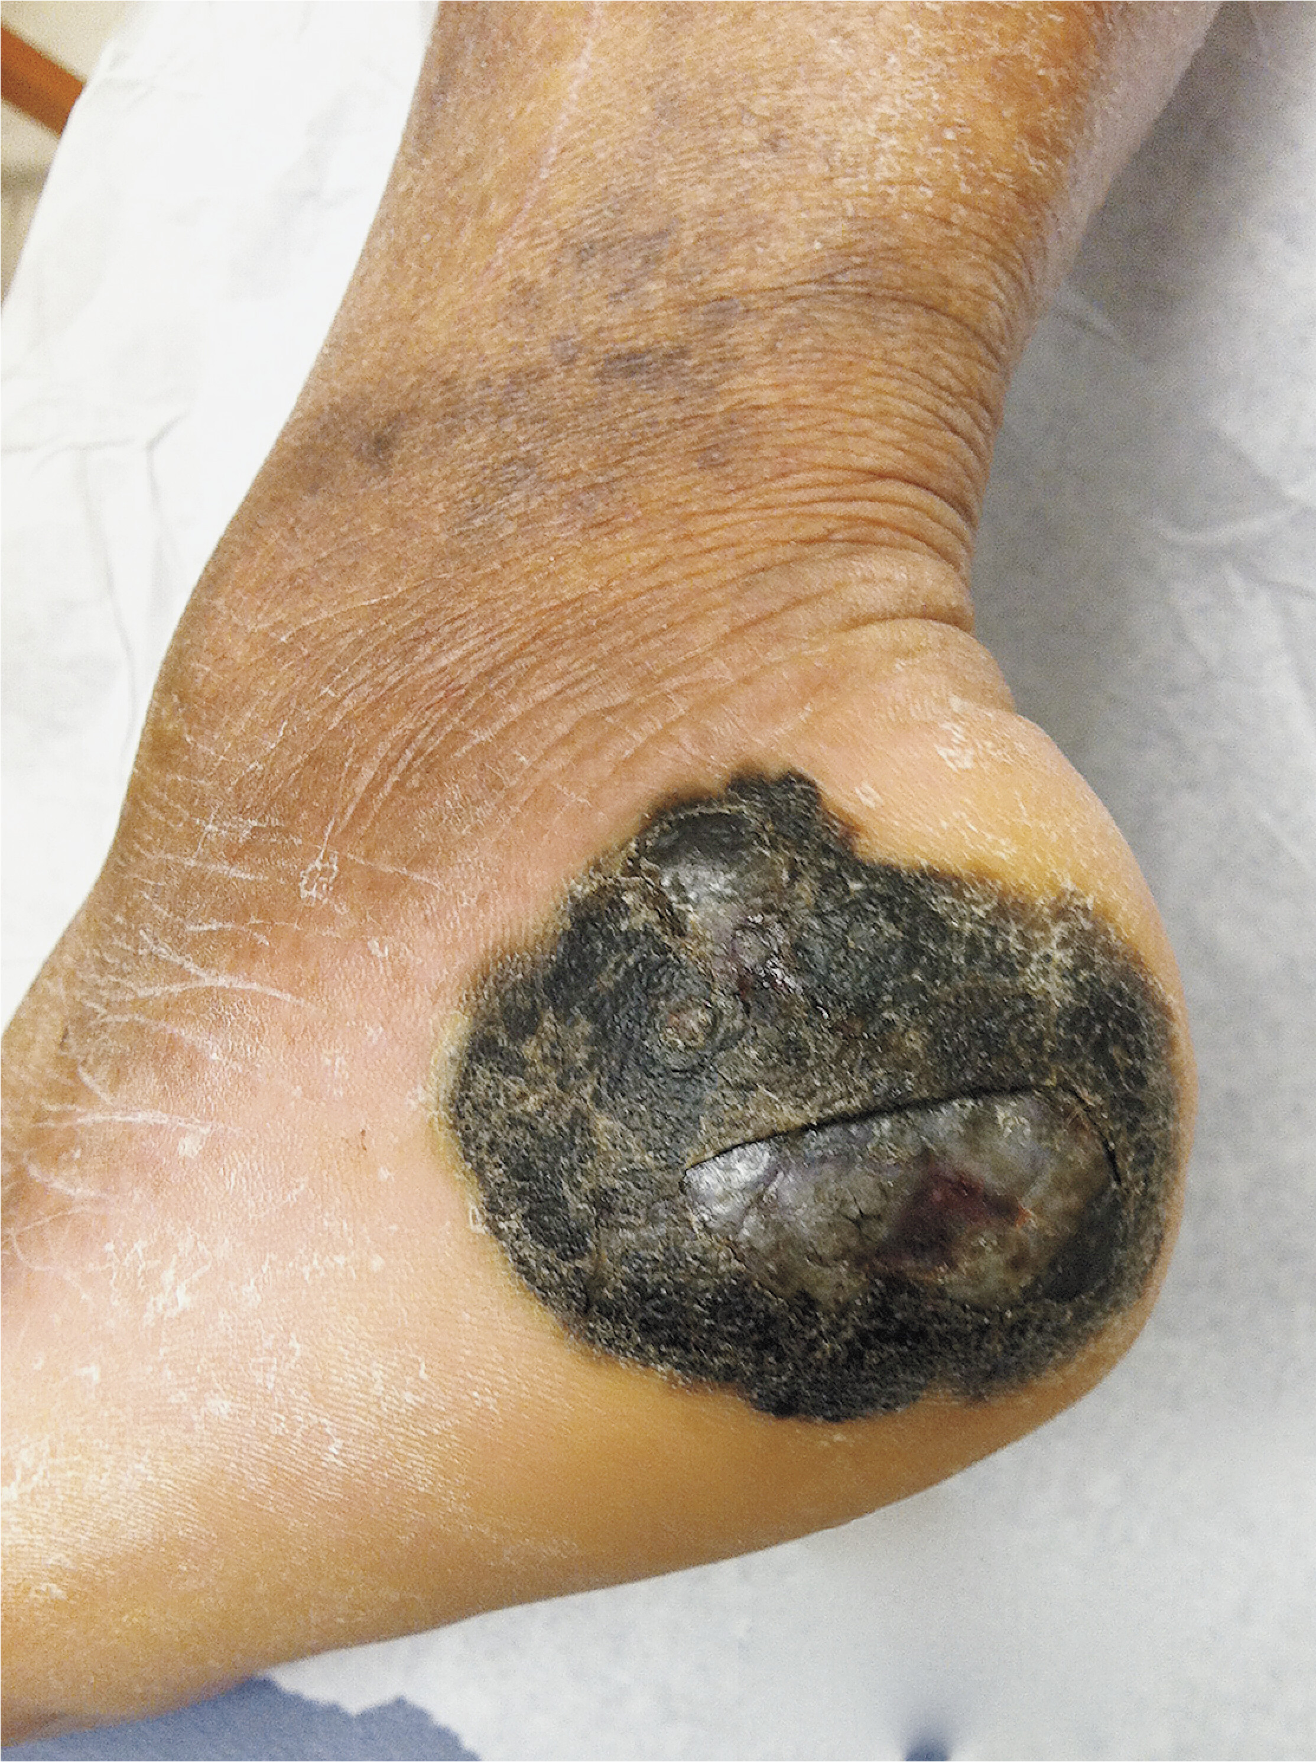
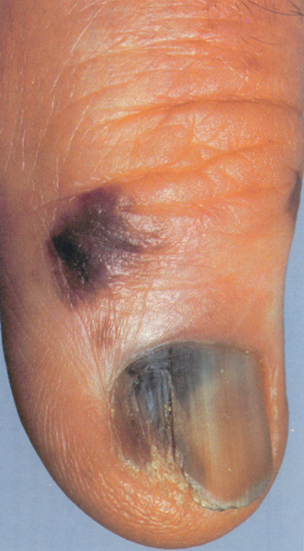
Acral lentiginous melanoma
Most frequent type of MM in the dark skinned.
Uneven pigmentation, nodulation, and ulceration.
Has an aggressive course with early metastases.
Palms, soles, and around the nails.

Slide 95
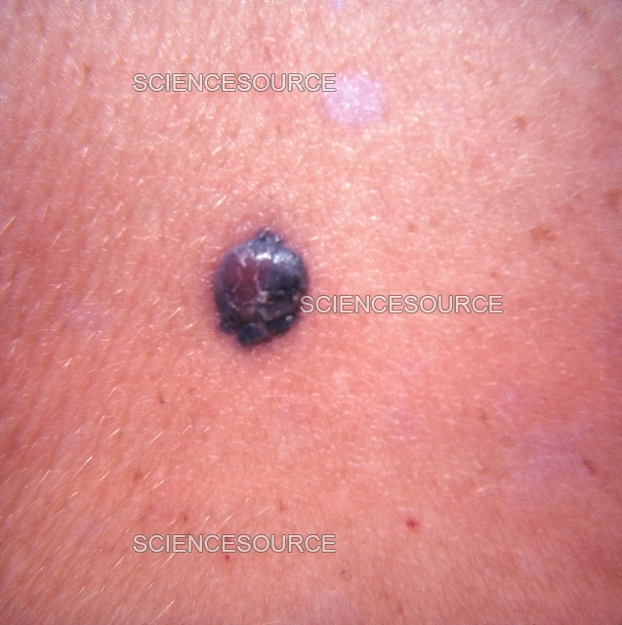
Nodular Melanoma
Aggressive subtype
Early vertical growth
Often presents as dark elevated nodule

Slide 96
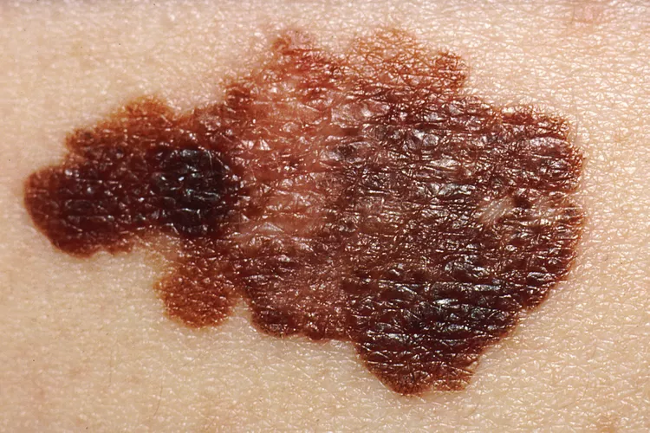
Superficial spreading melanoma
Most frequent type of MM.
Elevated plaque with color variation; may ulcerate.
Mostly seen on covered parts (legs in females, back in males).

Slide 97
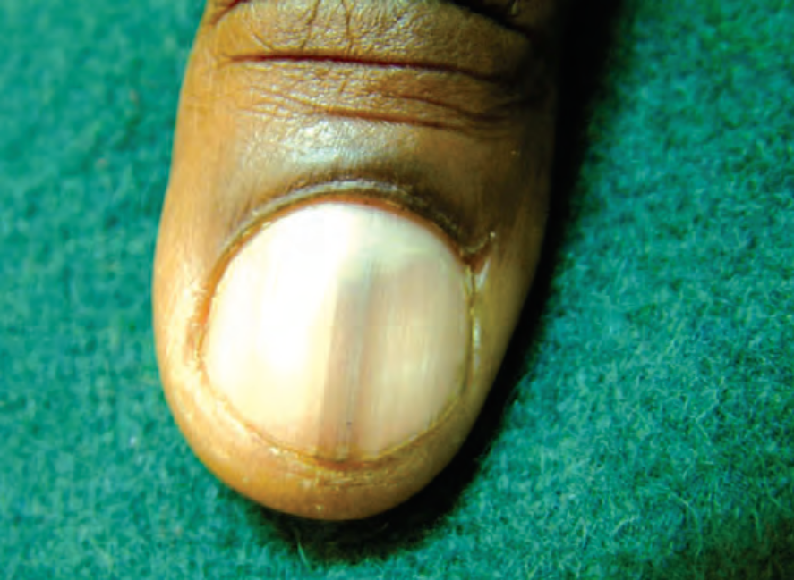
Less frequent variants
Metastatic melanomas: Are secondaries in the skin, lymph nodes, and viscera.
Subungual melanoma: Presents as painless pigmentation appearing subungually and spilling on to the nail fold (Hutchinson’s sign)
Malignant melanoma: Hutchinson’s sign

Slide 98
ABCDE criteria used to identify suspicious pigmented lesions that may represent malignant melanoma
 | Feature | Description
A | Asymmetry | One half of the lesion does not match the other half in shape, colour, or thickness.
B | Border irregularity | Edges are uneven, ragged, notched, scalloped, or poorly defined.
C | Colour variation | Presence of multiple colours within the same lesion, such as black, brown, tan, red, blue, white, or gray.
D | Diameter | Diameter greater than 6 mm (about the size of a pencil eraser), although melanomas can be smaller.
E | Evolution (or Enlargement) | Any change in size, shape, colour, elevation, or symptoms such as itching, bleeding, ulceration, or pain. This is often the most important warning sign.

Slide 99
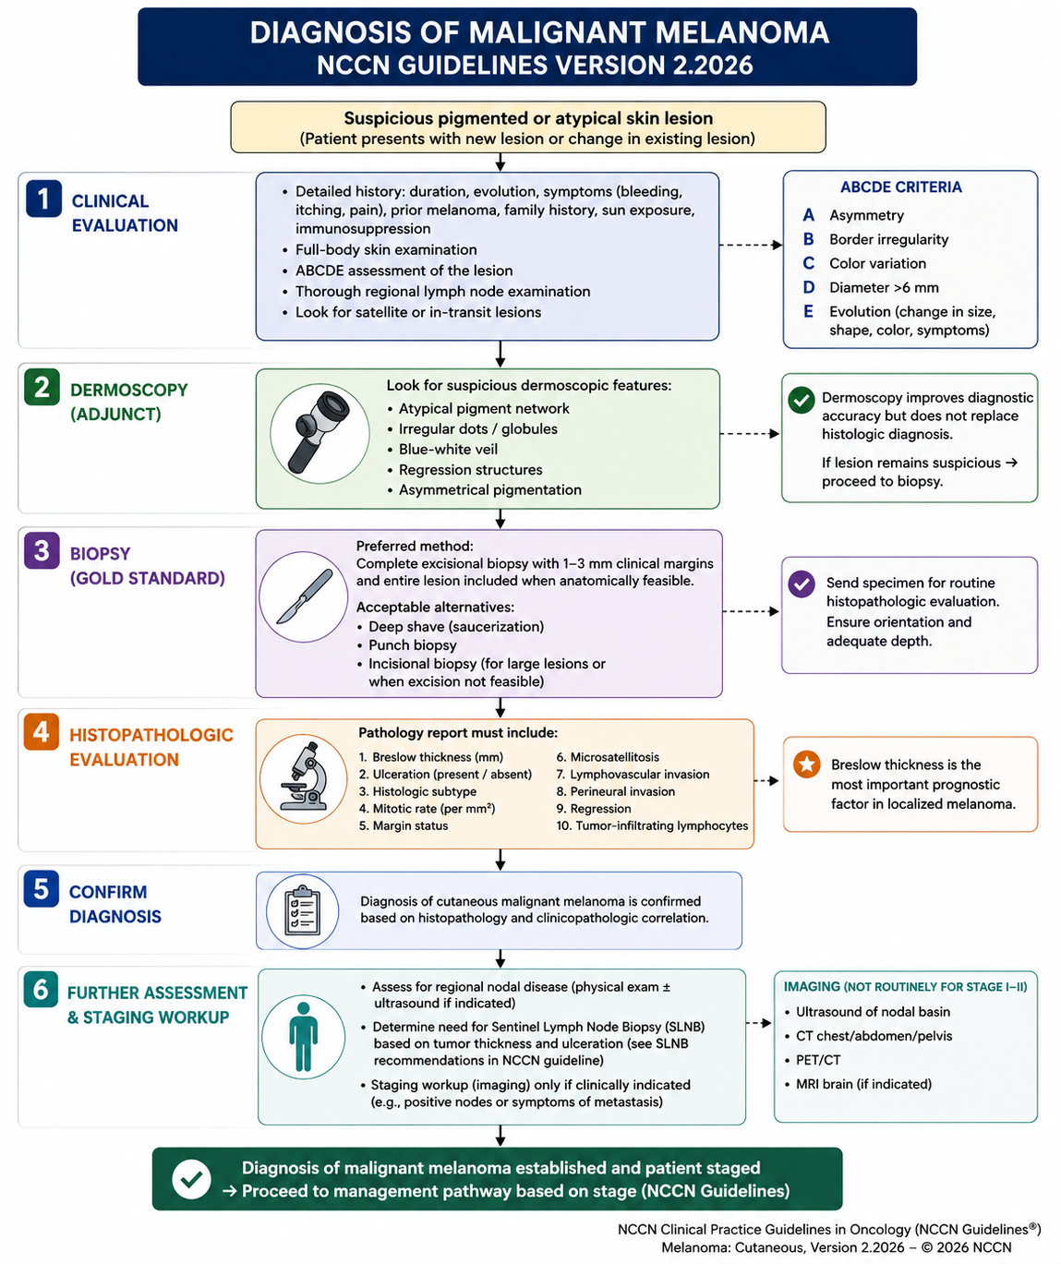
Notes:
Definition
A Sentinel Lymph Node Biopsy (SLNB) is a surgical procedure used to identify and remove the first lymph node(s) (sentinel node) that receives lymphatic drainage from the primary melanoma site. The node is examined histologically for microscopic metastasis.
The sentinel lymph node is considered the "gatekeeper" lymph node because melanoma cells usually spread there first before involving other regional lymph nodes.
NCCN-National comprehensive cancer network

Slide 100
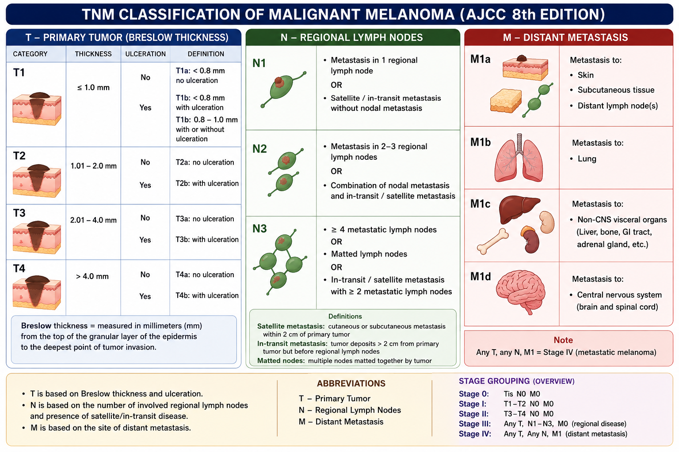

Slide 101
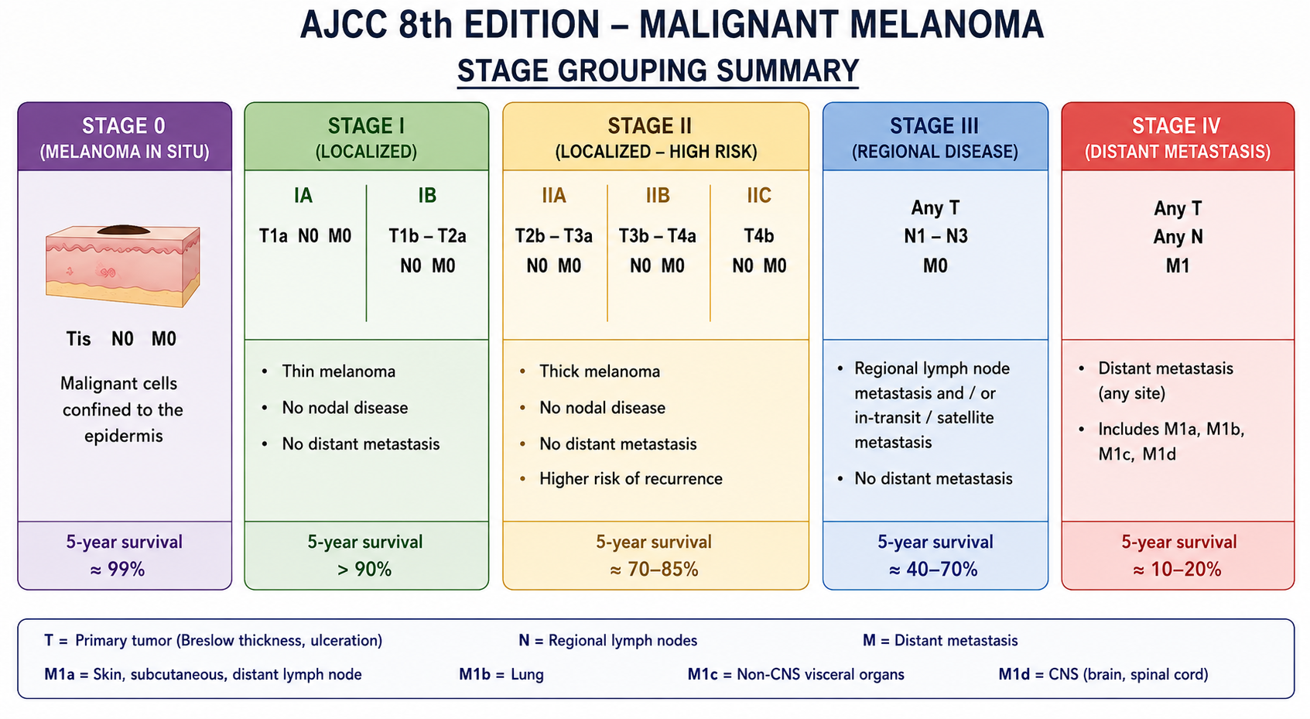

Slide 102
Treatment
Melanoma treatment is primarily determined by:
AJCC Stage
Breslow thickness
Ulceration
Sentinel lymph node status
Presence of BRAF V600 mutation
Resectability of disease
Melanoma: Cutaneous, Version 2.2026, NCCN Clinical Practice Guidelines In Oncology

Slide 103
Stage 0 (Melanoma In Situ)
Treatment
Wide local excision
Surgical Margin
0.5–1.0 cm
Additional Therapy
Not required
Prognosis
Near 100% cure rate after complete excision.
Stage I (IA–IB)
Treatment
Wide Local Excision (WLE)
Margins:
≤1 mm Breslow thickness → 1 cm margin
Sentinel Lymph Node Biopsy
Not routinely recommended for T1a
Discuss for T1b lesions
Adjuvant Therapy
Usually not indicated.
Notes:
Surgery is the definitive treatment for early-stage melanoma, with medical management generally reserved for adjuvant treatment of high-risk locally advanced melanoma and metastatic disease.

Slide 104
Stage II (IIA–IIC)
Primary Treatment
Wide local incision
Sentinel Lymph Node Biopsy
Recommended for:
T2
T3
T4 lesions
Adjuvant Therapy
High-risk Stage IIB/IIC:
Pembrolizumab
Nivolumab
These significantly reduce recurrence risk after surgery
Breslow Thickness | Margin
≤1 mm | 1 cm
1.01–2 mm | 1-2 cm
> 2 mm | 2 cm

Slide 105
Stage III (Regional Nodal Disease)
Microscopic stage III melanoma (Detected only by Sentinel Lymph Node Biopsy)
No palpable lymph nodes on examination
No radiological enlarged lymph nodes
Sentinel lymph node biopsy (SLNB) reveals microscopic metastasis
Surgery
Wide local excision
Adjuvant Immunotherapy (Preferred)
Pembrolizumab
Nivolumab
BRAF-Mutated Melanoma
Targeted therapy:
Dabrafenib +
Trametinib

Slide 106
Nodal basin ultrasound surveillance
Serial ultrasound monitoring of regional lymph nodes after a positive SLNB
This currently preferred approach after a positive SLNB over routine completion lymph node dissection (CLND)
Routine CLND does not improve melanoma specific survival but increases complications, especially lymphedema.
MSLT-II and DeCOG-SLT clinical trials

Slide 107
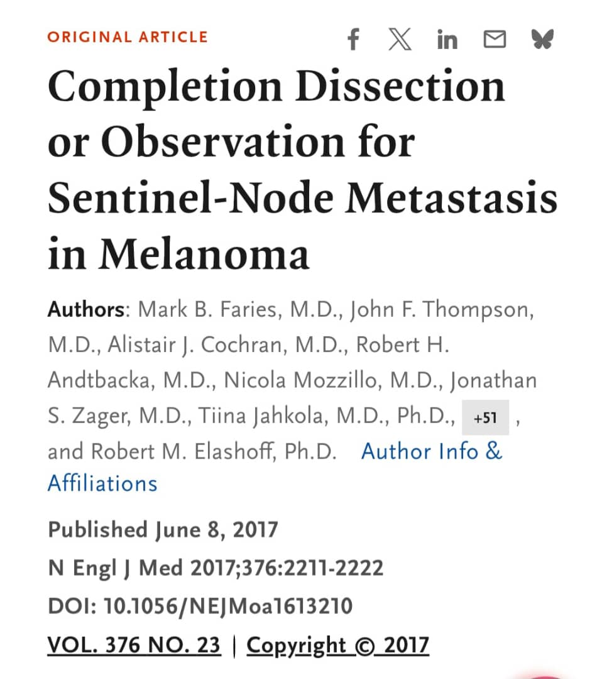
Notes:
Multicenter Selective Lymphadenectomy Trial II (MSLT-II)

Slide 108
Article review
Study objective
To whether patients with sentinel lymph node (SLN)-positive melanoma benefit from immediate Completion Lymph Node Dissection (CLND) compared with careful observation using serial nodal ultrasound surveillance.
Study design
International, multicenter, phase III randomized trial.
1,939 patients with melanoma and a positive SLN were enrolled.
Patients were randomized to:
Immediate Completion Lymph Node Dissection (CLND)
Observation with nodal basin ultrasound surveillance

Slide 109
Primary Endpoint
Melanoma-Specific Survival (MSS)
Key Results
1. Melanoma-Specific Survival
No significant difference between the two groups.
Three-year melanoma-specific survival was approximately 86% in both groups.
2. Overall Survival
No significant difference between immediate CLND and observation.
Conclusion: Immediate completion lymph node dissection does not improve melanoma-specific survival or overall survival in patients with sentinel lymph node-positive melanoma
Limitation: Median follow-up was relatively short (~43 months/3years) for assessing long-term melanoma outcomes.
Notes:
Clinical Impact
MSLT-II changed melanoma management worldwide and influenced guidelines from organizations such as the National Comprehensive Cancer Network and other international melanoma groups.
Current practice for most patients with microscopic Stage III melanoma (SLN-positive disease) is:
Wide local excision of the primary melanoma.
Sentinel lymph node biopsy.
If the SLN is positive:
Observation with regular nodal ultrasound surveillance (preferred).
Consider adjuvant systemic therapy.
Reserve CLND for selected situations.

Slide 110
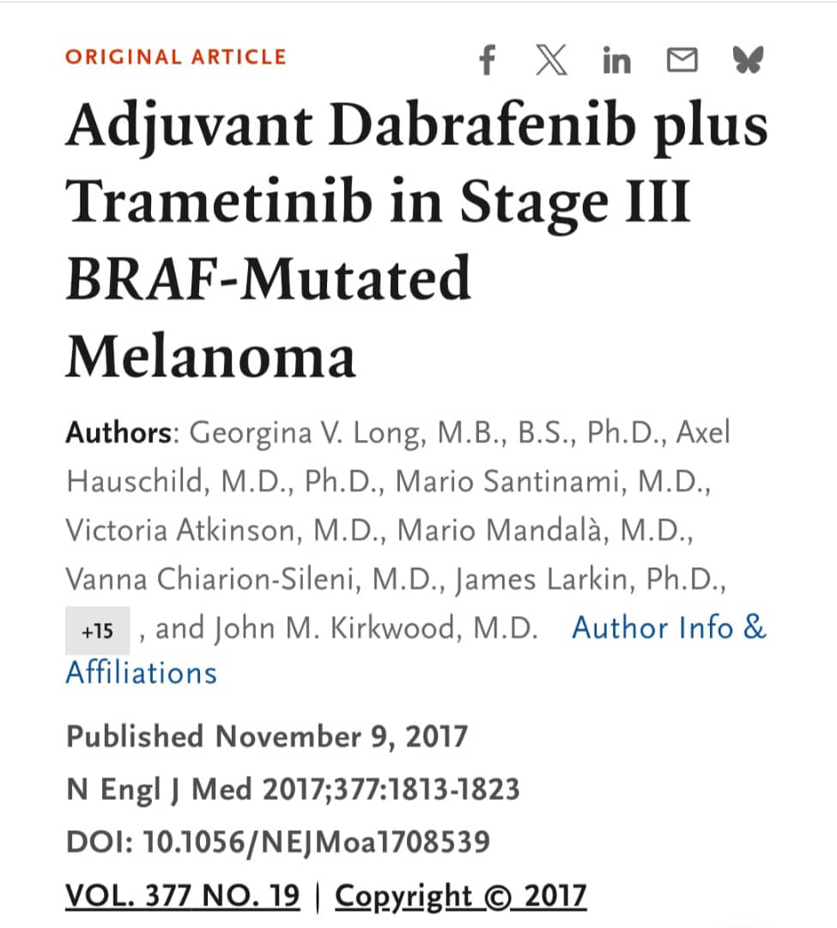
Notes:
COMBI-AD Trial: Adjuvant Dabrafenib Plus Trametinib in Stage III BRAF-Mutated Melanoma

Slide 111
Article review
Study objective
To evaluate whether adjuvant targeted therapy with dabrafenib plus trametinib can improve clinical outcomes and reduce the risk of melanoma recurrence in patients with completely resected Stage III BRAF V600 mutation-positive melanoma.
Study design
Phase III randomized controlled trial,
Double-blind, Placebo-controlled, Multicenter international study
870 patients enrolled
Randomized 1:1 to: Dabrafenib + Trametinib for 12 months (438 patients) or Placebo for 12 months (432 patients

Slide 112
Primary Endpoint
Relapse free survival (RFS)
Key results
Relapse free survival
Risk of relapse or death reduced by 53% compared with placebo (HR 0.47; 95% CI 0.39–0.58)
2. Overall survival
Improved with targeted therapy
5-Year Relapse-Free Survival
52% with dabrafenib/trametinib vs 36% with placebo
Notes:
RFS; Defined as the time from randomization to melanoma recurrence or death from any cause

Slide 113
Conclusion
The study established dabrafenib plus trametinib as a standard adjuvant treatment option for resected Stage III BRAF-mutant melanoma.
Limitations
Included only patients with BRAF V600E or V600K mutations, limiting generalizability to BRAF wild-type melanoma

Slide 114
2. Clinically Detectable Resectable Stage III Melanoma
Regional nodal disease is evident before surgery.
Detected by:
Palpable lymph node
Ultrasound
CT
PET-CT
Biopsy-confirmed nodal metastasis
Neoadjuvant Therapy (New NCCN Direction)
Pembrolizumab
Combination immunotherapy in selected patients
Surgery
Wide local excision
Therapeutic lymph node surgery when indicated
Pathological response assessment
Adjuvant Therapy/ Observation
Notes:
Neoadjuvant therapy is increasingly favoured because pathologic response strongly predicts outcomes, treat micro metastatic disease early, may shrink nodal disease

Slide 115
Stage IV (Metastatic Melanoma)
First-Line Systemic Therapy (Preferred Immunotherapy)
Single-Agent PD-1 Inhibitor
Pembrolizumab
Nivolumab
Dual Checkpoint Blockade
Ipilimumab +
Nivolumab
Higher response rates but greater toxicity

Slide 116
BRAF V600 Mutation Positive
Preferred targeted therapy:
Dabrafenib +
Trametinib
Alternative combinations:
Encorafenib +
Binimetinib
Vemurafenib +
Cobimetinib
Targeted therapy produces rapid responses and is useful in symptomatic or rapidly progressive disease.

Slide 117
Radiation Therapy
Indications
Brain metastases
Unresectable disease
Palliation
Desmoplastic melanoma with high local recurrence risk
Selected nodal disease
Radiotherapy is generally adjunctive rather than primary treatment

Slide 118
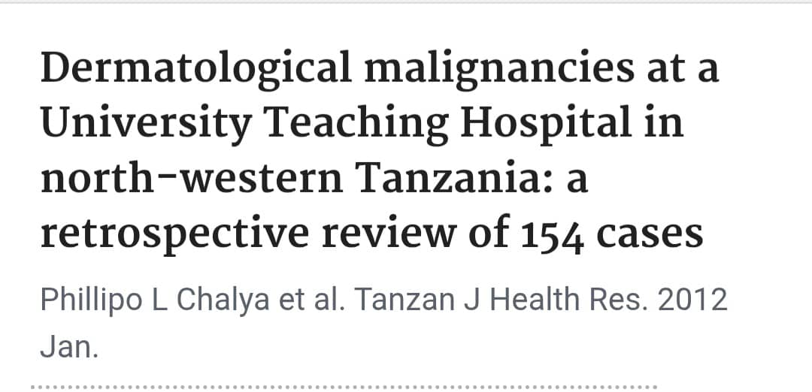

Slide 119
Study type
Retrospective hospital-based descriptive study
Study population
154 patients with histologically confirmed dermatological malignancies managed at Bugando Medical Centre, Mwanza, Tanzania, over a 10-year period.
Objective
To determine the prevalence, histopathological pattern, anatomical distribution and treatment outcome of dermatological malignancies at Bugando Medical Centre in North-western Tanzania

Slide 120
Study results
The majority of patients were in the 5th and 6th decades of life.
Malignant melanoma was the most common dermatological malignancy (67.5%) followed by Kaposi's sarcoma (10.4%), Squamous cell carcinoma (8.4%) and Basal cell carcinoma (7.8%).
The lower limbs were the most frequent site accounting for 55.8%.
Wide local excision was the most common surgical procedure performed in 79.2% of cases.
Post-operative wound infection was the most common complication in 58.3% of patients.
Mortality rate was 3.8%

Slide 121
Conclusion and recommendation
Dermatological malignancies are more prevalent in our setting. A high index of suspicion is needed to avoid labelling malignancies "chronic ulcers" and all suspected lesions should be biopsed

Slide 122
References
Hafner C , Vogt T .Seborrheic keratosis .J Dtsch Dermatol Ges 2008; 6: 664.
Product Profile for Cutaneous Neurofibromas: Clinical Trials to prevent , Arrest , or Regress cutaneous Neurofibromas. J Invest Dermatol 2023; 143: 1388.
Shah R ,Jindal A, Patel N .Acrochordons as a cutaneous sign of metabolic syndrome: a case – control study. Ann Med Health Sci Res 2014; 4: 202
Schmults CD, Blitzblau R, Aasi SZ, et al. Basal Cell Skin Cancer, Version 2.2024, NCCN Clinical Practice Guidelines in Oncology. Journal of the National Comprehensive Cancer Network. 2023;21(11):1181-1203.
Drucker AM, Adam GP, Rofeberg V, Gazula A, Smith B, Moustafa F, Weinstock MA, Trikalinos TA. Treatments of Primary Basal Cell Carcinoma of the Skin: A Systematic Review and Network Meta-analysis. Ann Intern Med. 2018 Oct 2;169(7):456-466. doi: 10.7326/M18-0678. Epub 2018 Sep 18. PMID: 30242379.
Wolf, D.J. and Zitelli, J.A., 1987. Surgical margins for basal cell carcinoma. Archives of dermatology, 123(3), pp.340-344.

Slide 123
Wang M, et al. Recent Global Patterns in Skin Cancer Incidence, Mortality and Burden, 2024–2025
Roky AH, et al. Overview of Skin Cancer Types and Prevalence Rates Across Continents, 2025
Faries MB, Thompson JF, Cochran AJ, et al. Completion Dissection or Observation for Sentinel-Node Metastasis in Melanoma. N Engl J Med. 2017;376(23):2211–2222. doi:10.1056/NEJMoa1613210
Michielin O, van Akkooi ACJ, Ascierto PA, Dummer R, Keilholz U; ESMO Guidelines Committee. Electronic address: clinicalguidelines@esmo.org. Cutaneous melanoma: ESMO Clinical Practice Guidelines for diagnosis, treatment and follow-up†. Ann Oncol. 2019 Dec 1;30(12):1884-1901. doi: 10.1093/annonc/mdz411. PMID: 31566661.

Slide 124
Barthelmann S, Bustch F, Lang BM, et al. Seborrheic keratosis.J Dtsch Dermatol Ges 2023; 21:262
Khanna N, Sacchidanand S, Khopkar U, editors. IADVL Textbook of Dermatology. 4th ed. Mumbai: Bhalani Publishing House; 2023.
Clinical Dermatology : 3rd ed. John Hunter, John Savin and Mark Dahl
Fitzpatrick's Dermatology. Kang S, Amagai M, Bruckner AL, et al., editors. New York: McGraw-Hill Education; 2019.
Chalya PL, Gilyoma JM, Kanumba ES, Mawalla B, Masalu N, Kahima KJ, et al. Dermatological malignancies at a University Teaching Hospital in north-western Tanzania: a retrospective review of 154 cases. Tanzan J Health Res. 2012;14(1):9-14.

